Slide 1
Beeg Ship
By Lorenzo Cabrera, Josue Cruz, Brice Higa, Christopher Koepke, Lance Martinez

Slide 2
What is the issue we are addressing?
The issue we are trying to address has to do with the drop in in-store traffic due to the current pandemic and an overall shift to online shopping. While retailers across the nation have seen a decrease in in-store purchases, online activity and thus online purchases has increased.
A company, let’s call them Company X, seeks to meet this increased demand of online shopping by acquiring the services of a third party with a system and infrastructure capable of shipping products that are being purchased online while offering reasonable rates.

Slide 3
Our proposal:
BeegShip proposes the following:
Build a shipping system that will work with Company X’s inventory and customer information subsystem.
The shipping system will allow customers to order products online, from the comfort of their home.
The shipping subsystem will have the following features:
Receiving packages
Processing packages
Preparing packages for delivery
Maintaining an up-to-date status on the given order

Slide 4
Our Approach to this problem:
Our approach to build our shipping system will go through four stages:
Analysis: Gather information, define requirements, prioritize based on important features, and receive information from customers (include diagrams).
Design: utilize diagrams and gathered information to develop the skeleton of our system, develop a database schema and create tables in 3N form according to business needs.
Implementation: develop our system Graphical User Interface (GUI), complement methods and classes.
Estimated Completion Time: The estimated time that we set for completing our shipping subsystem was 11-13 weeks

Slide 5
Some of the Policies of our company
BeegShip will provide shipping across and outside of U.S and estimate the best/most comfort shipping prices.
Free Shipping for U.S orders.
BeegShip will ship products only within a certain number of business days.
Returns will be allowed within the first 30 days after receiving the product.
Cancel order will not be available after product has been shipped.

Slide 6
Analysis
Benefits:
We want BeegShip to provide quick and reliable service to companies and allow them to make more sales, even with reduced stored traffic.
Stakeholders:
BeegShip executives, Warehouse personnel, shipping personnel, Company X and other business partners.
Events to what the system must respond:
Receive Shipping Request
Update Order
Prepare Package
Send Package
Contact Customer

Slide 7
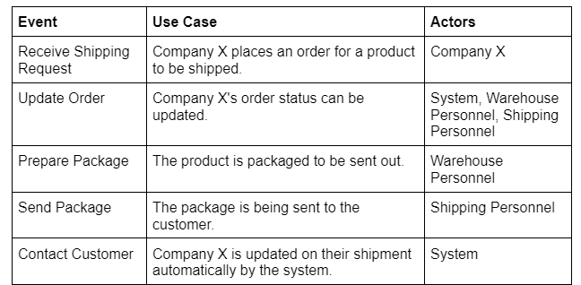
Events

Slide 8
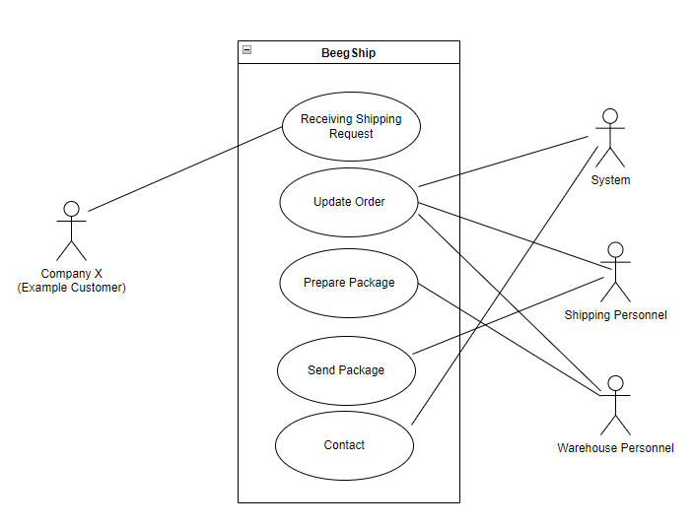
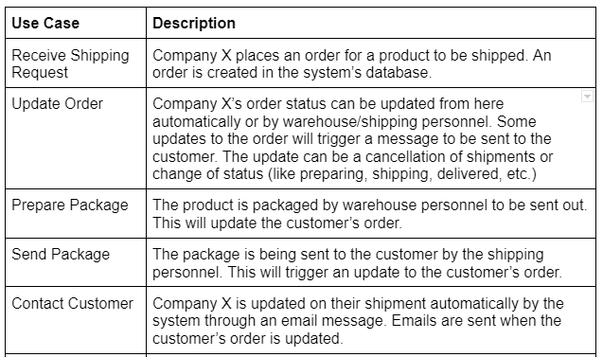
Use Case Descriptions and Use Case Diagram

Slide 9
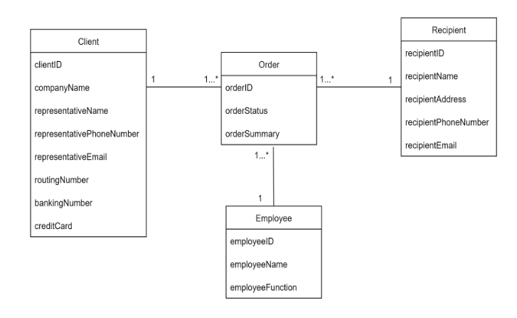
Phase 2 of Analysis Part
Creating the initial Domain Class Diagram for BeegShip:

Slide 10
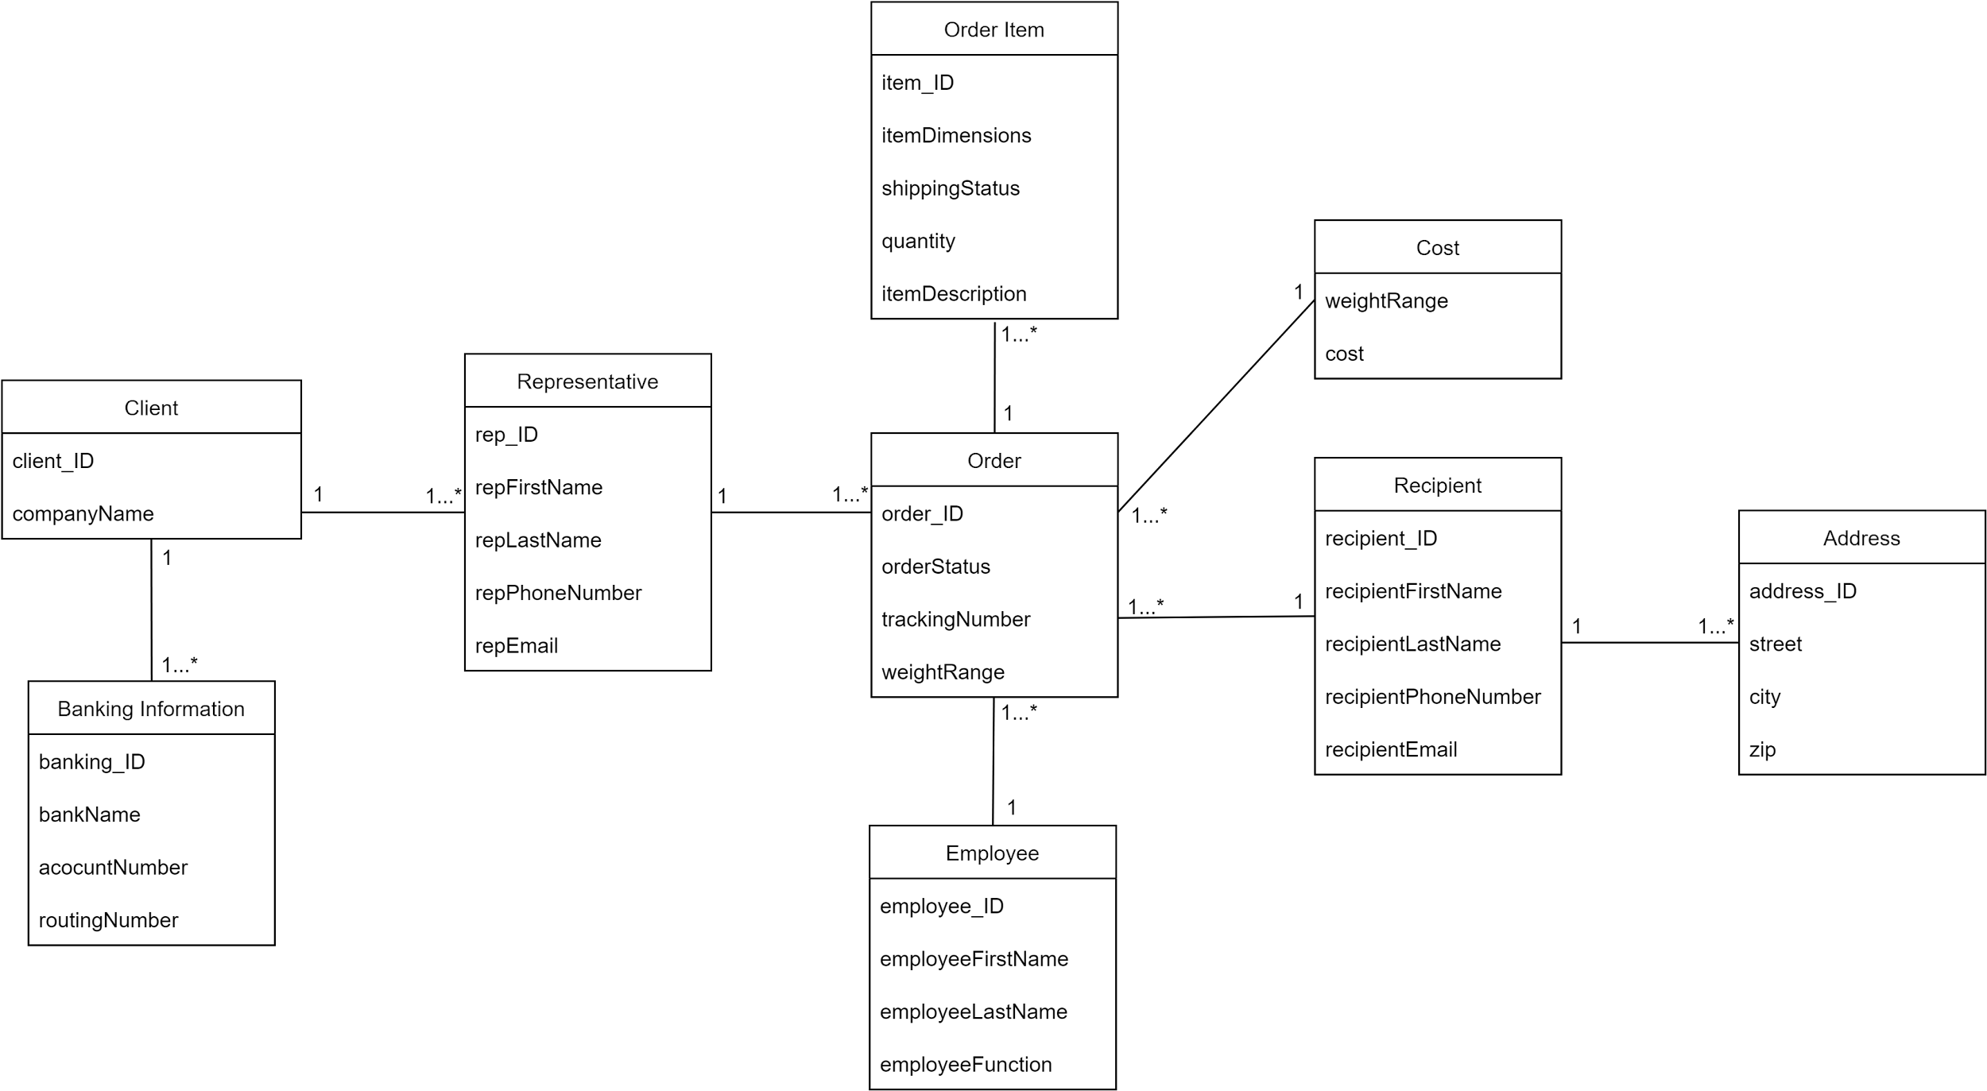
Updated Domain Class Diagram

Slide 11
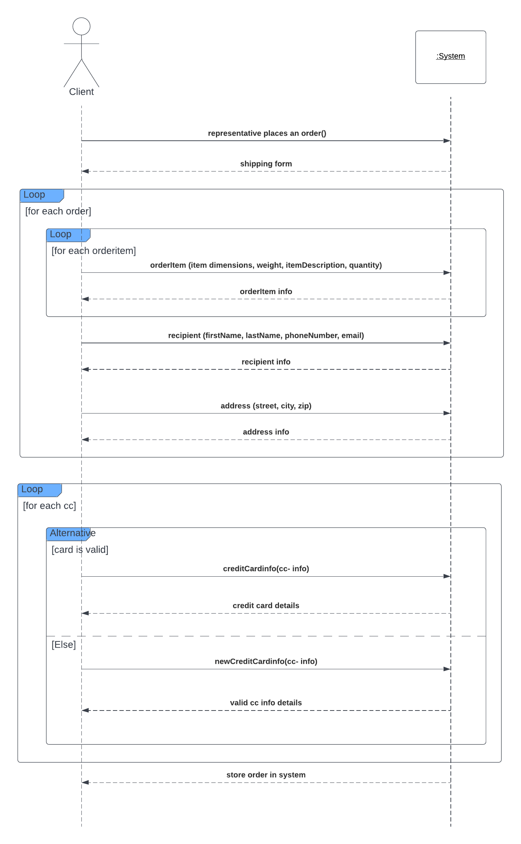
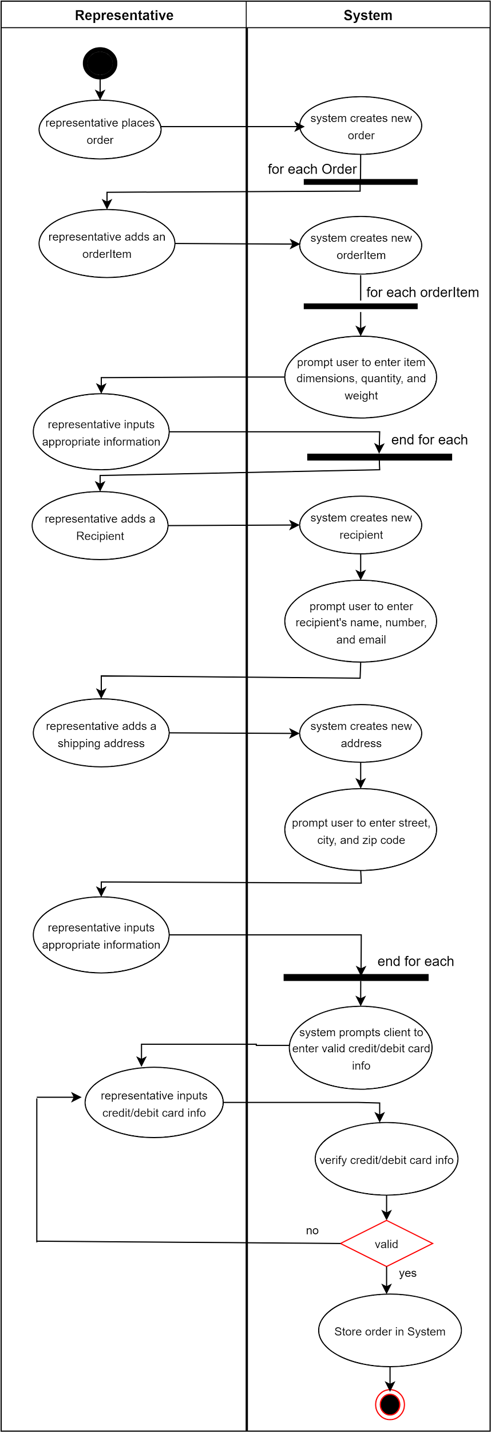
Activity Diagram/SSD

Slide 12
Design Phase
Design phase corresponds to creating a relational database and User interfaces that will interact with our system.
First, we create relationship tables between user and system and build hypothetical story boards.
story boards will show the interactions between the User and UI of our shipping system.

Slide 13
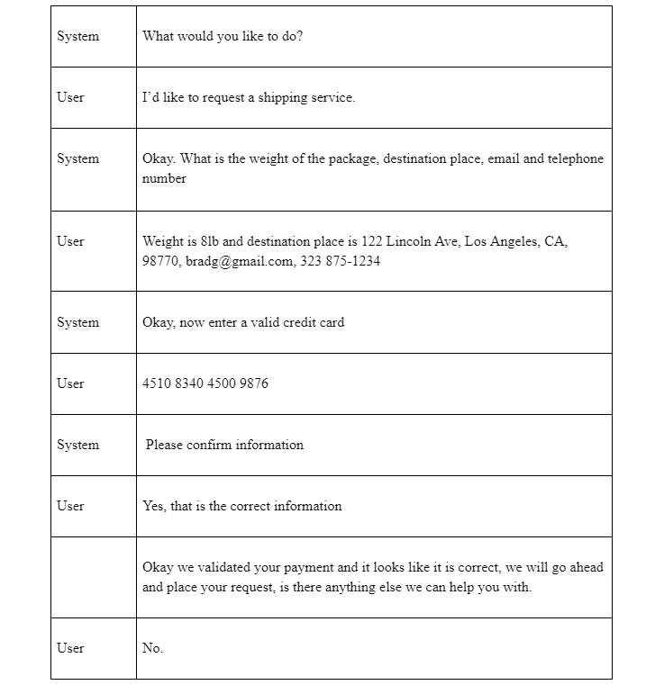
Relationship table/ Storyboard
In order to understand the messages
Exchanged between users and our
System, we create dialogs that would
For all of use cases.
The following chart shows the dialog
Between a customer requesting
a shipping request.

Slide 14
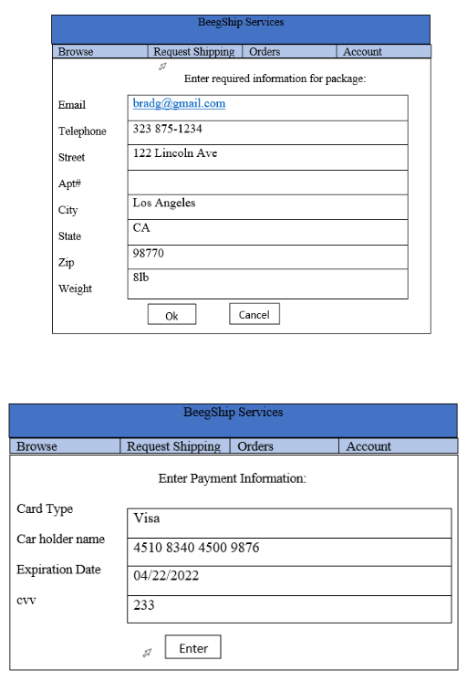
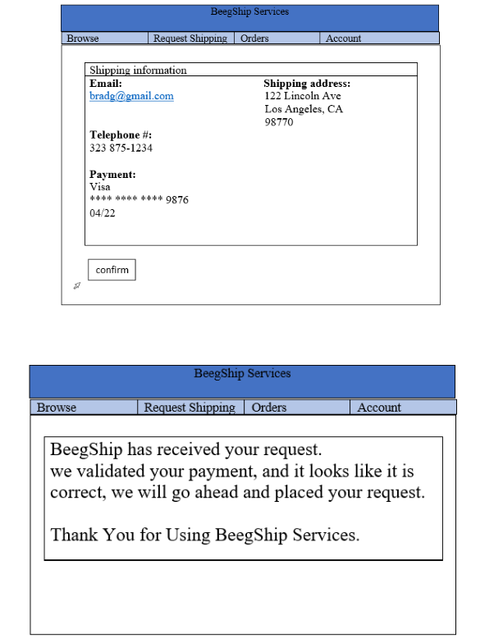
Storyboard

Slide 15
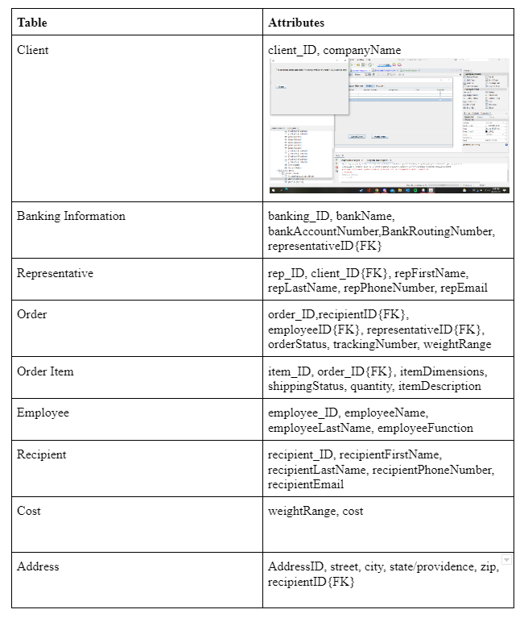
Normalized Table and Schema
Our 3NF normalized database will consist of nine 3NF
tables:
Client
Banking Information
Preparing packages for delivery
Representative
Order
Order Item
Employee
Recipient
Cost
Address

Slide 16
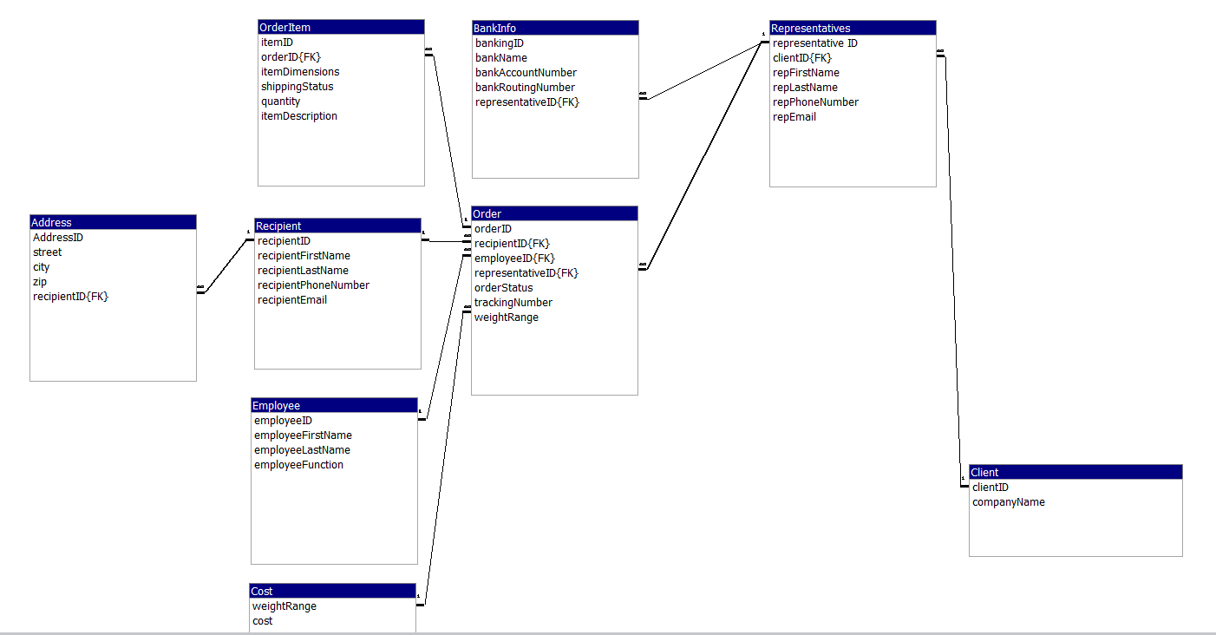
Schema

Slide 17
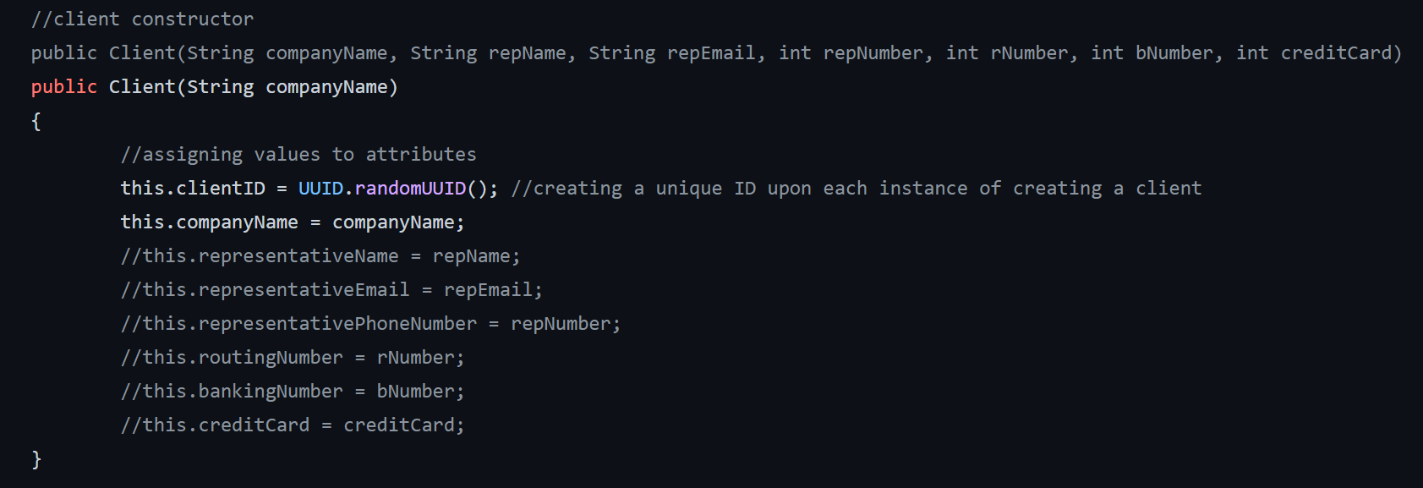
Our Implementation
Creating a Client

Slide 18
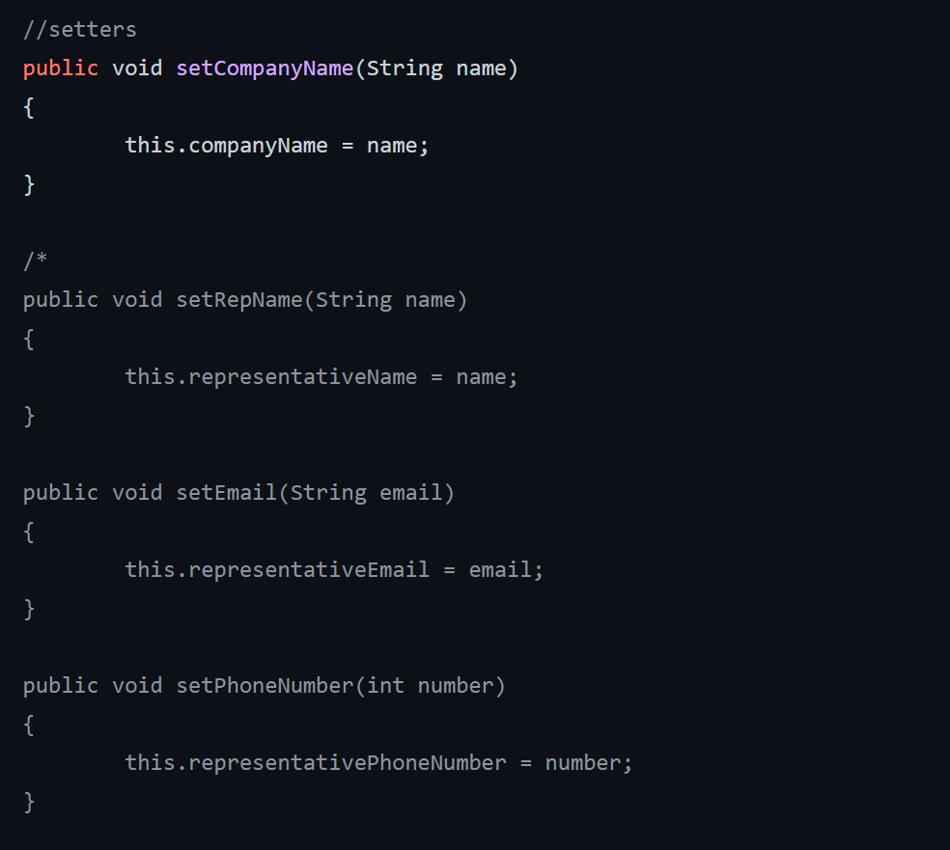
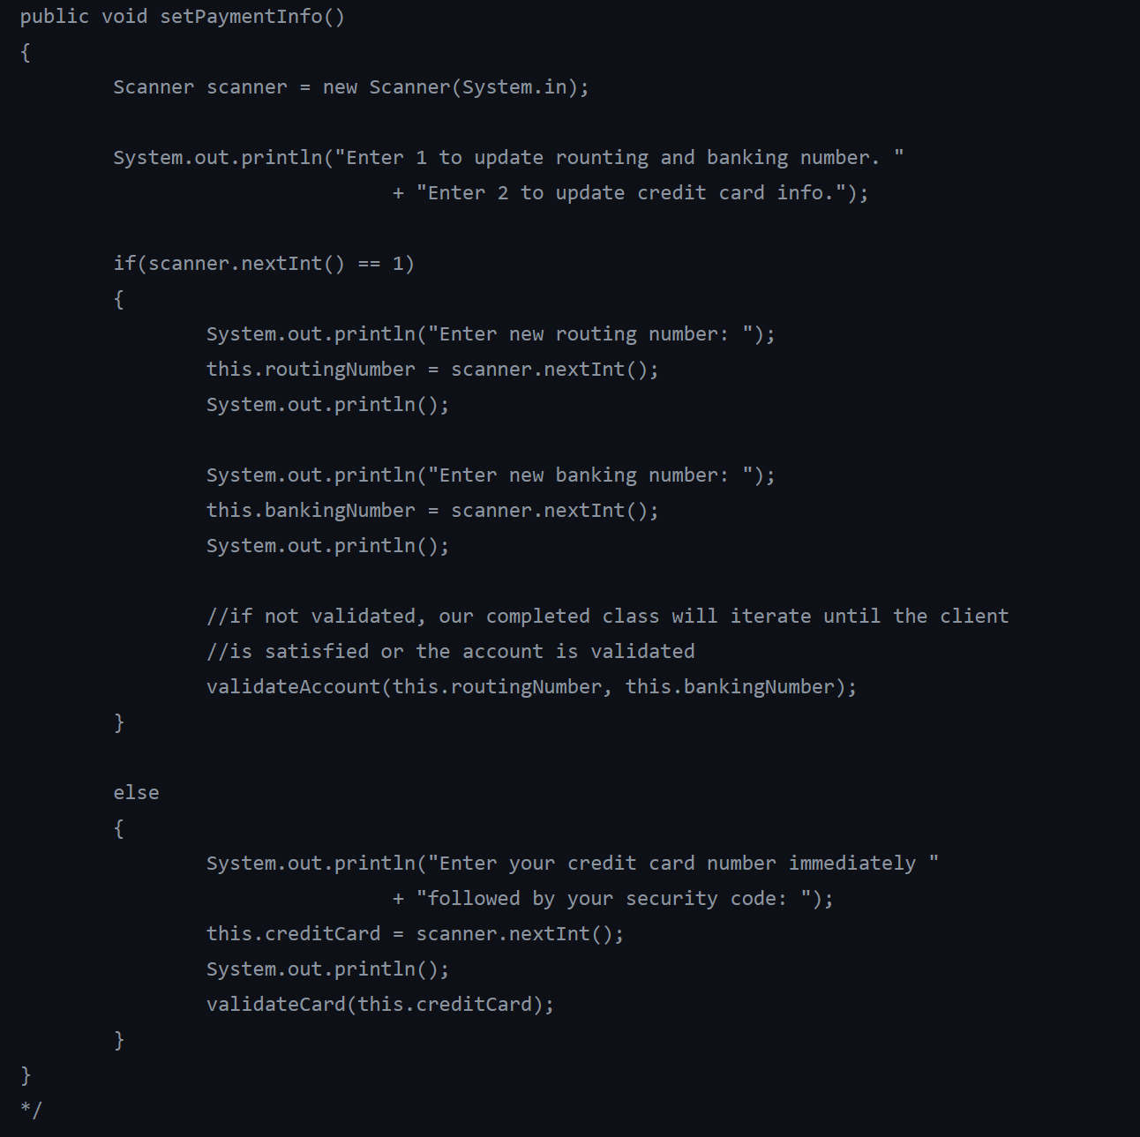

Slide 19
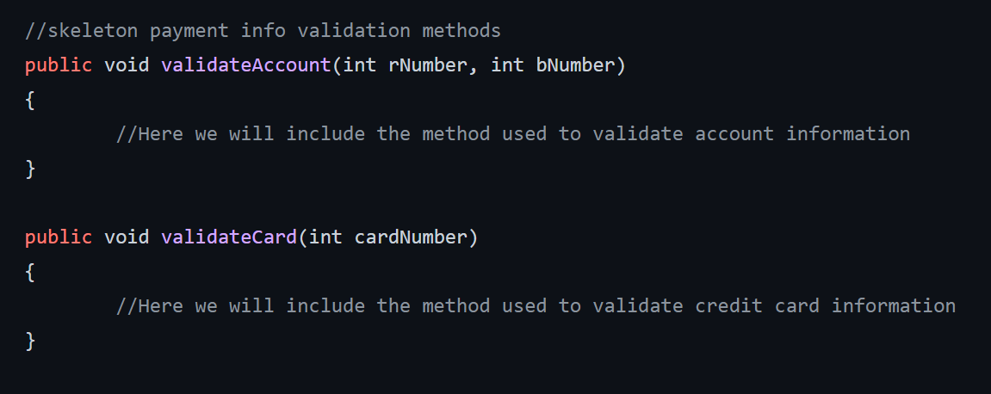
Our Implementation
Creating a Client

Slide 20
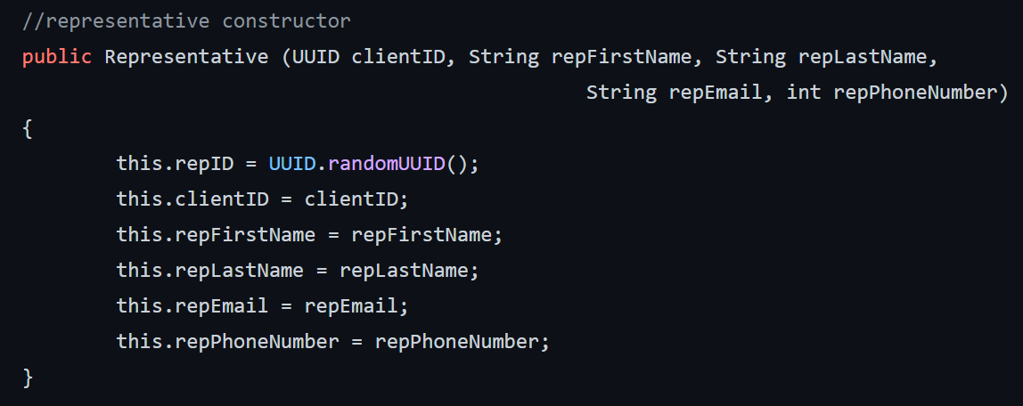
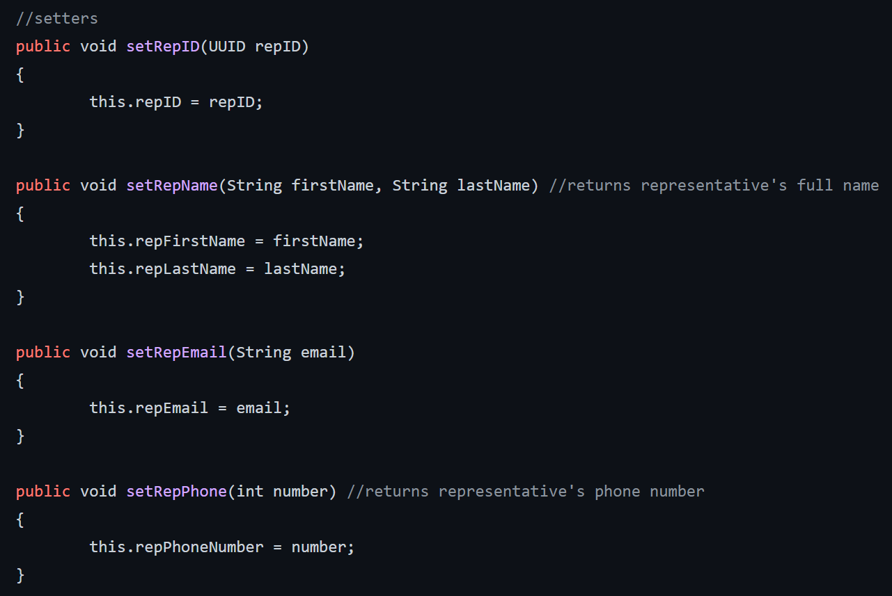
Our Implementation
Creating a Representative

Slide 21
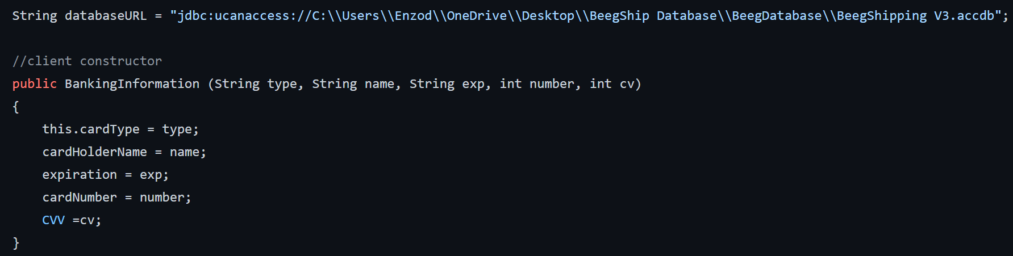
Our Implementation
Creating Banking Information

Slide 22
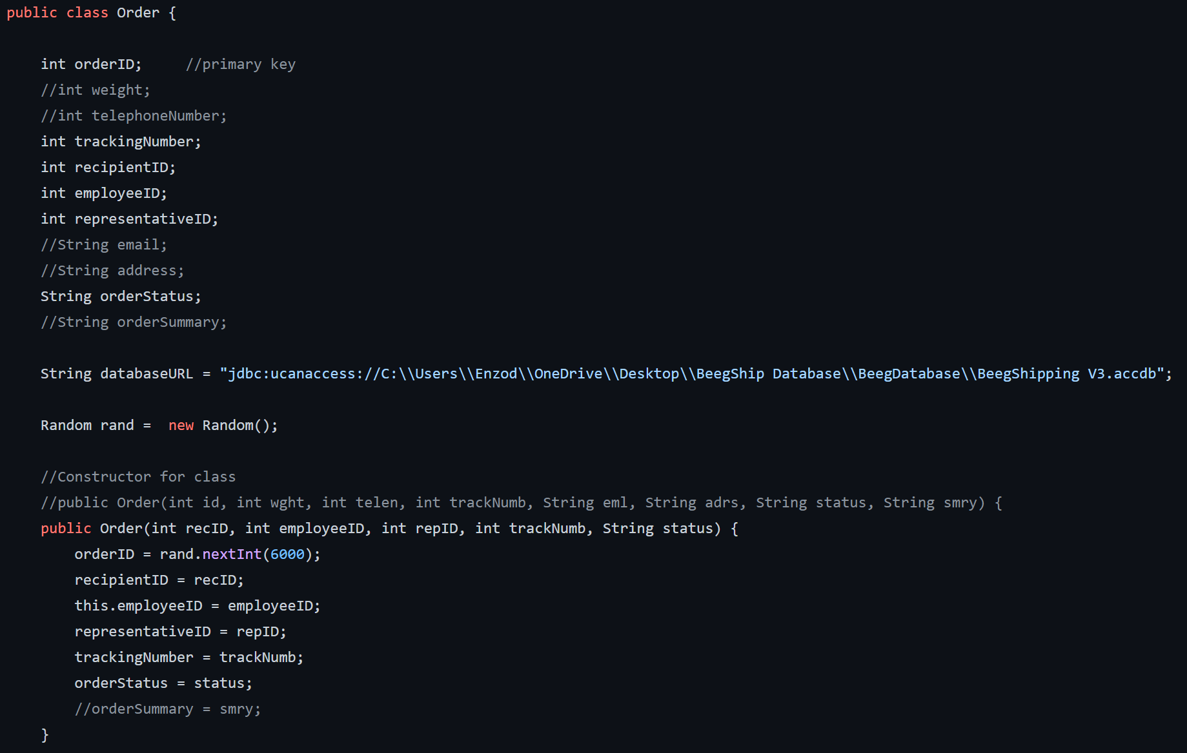
Our Implementation
Creating an Order

Slide 23
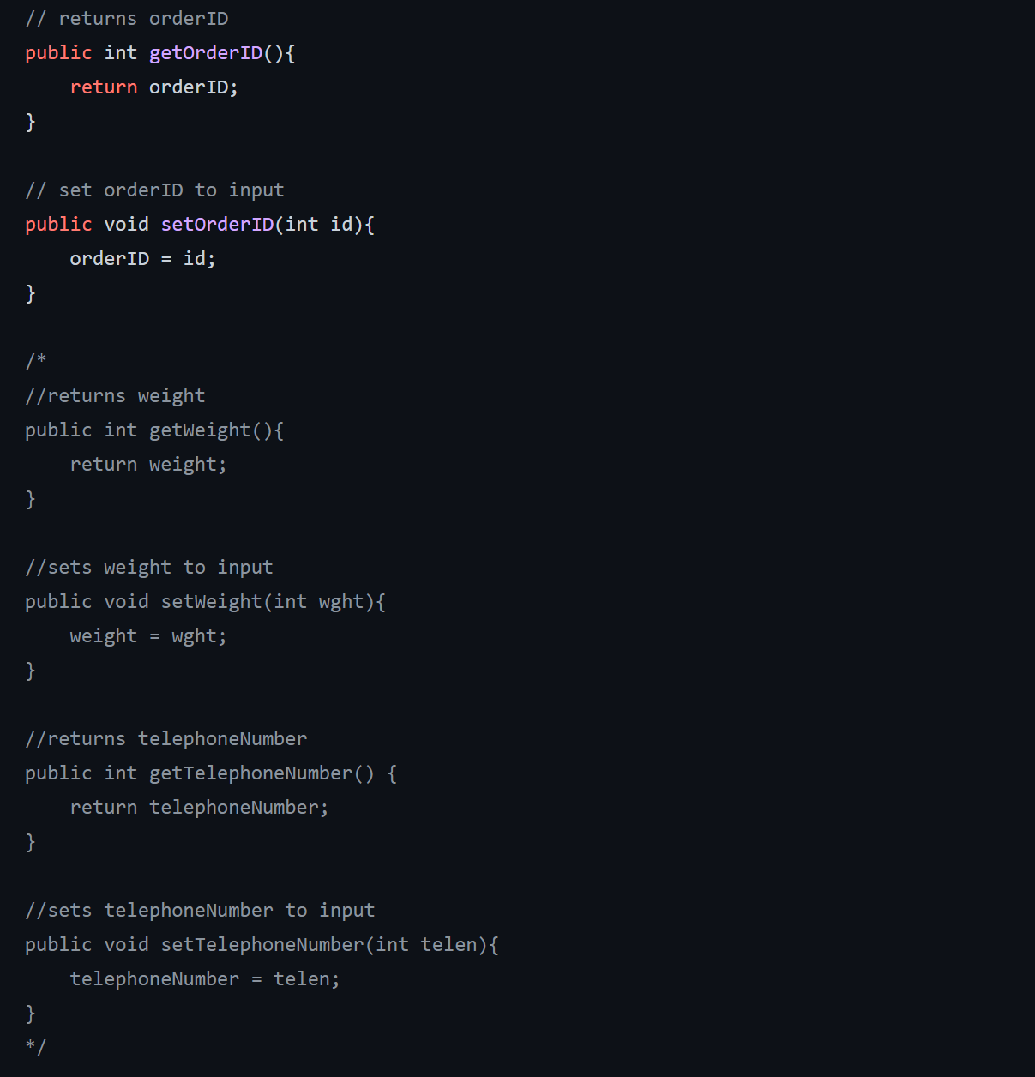
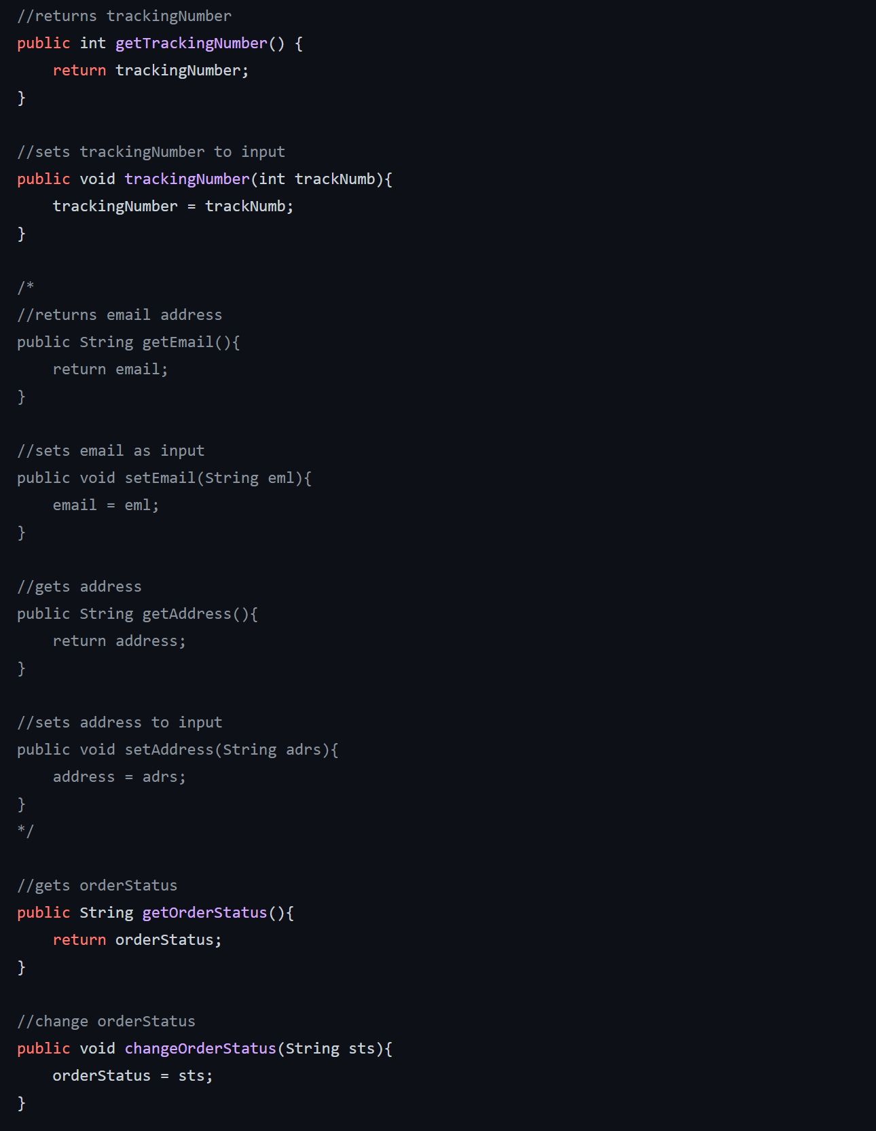
Our Implementation
Creating an Order

Slide 24
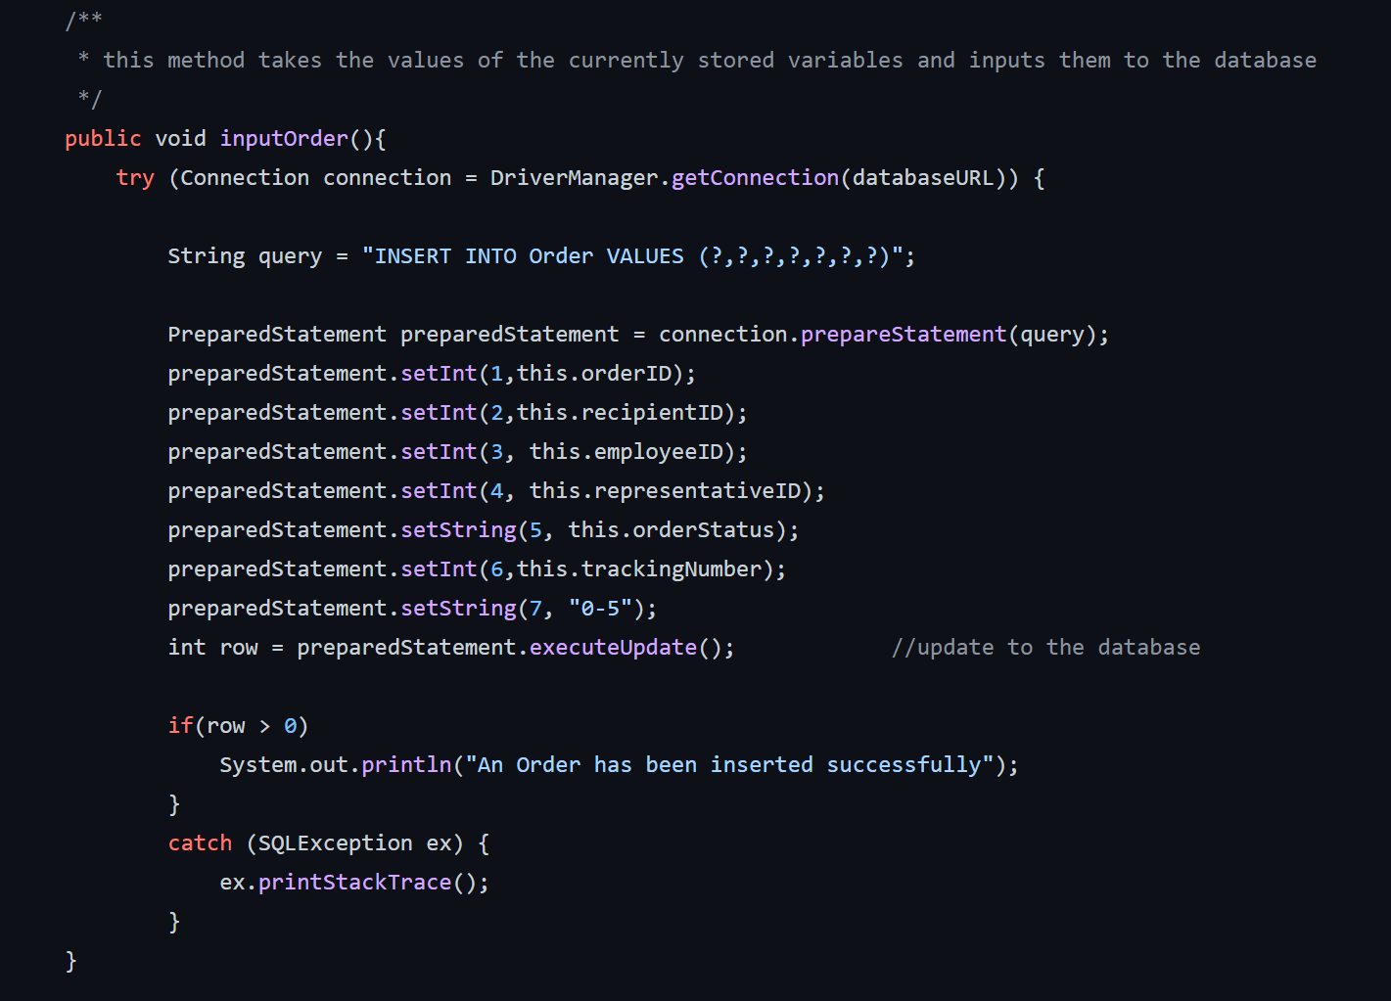
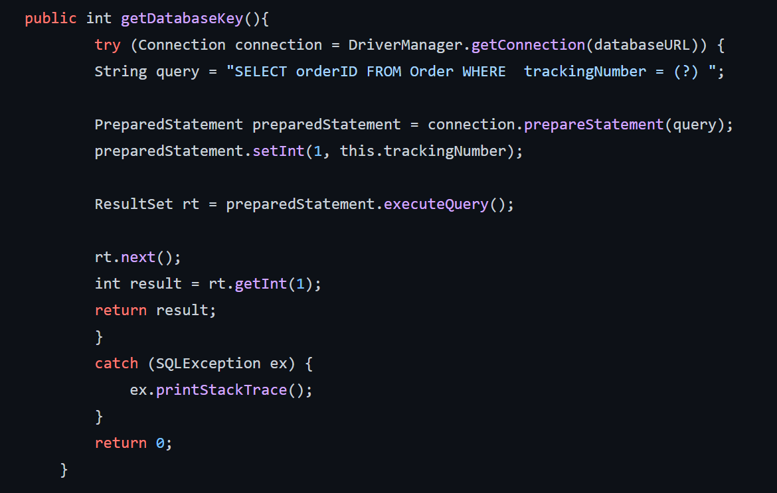
Our Implementation
Creating an Order

Slide 25
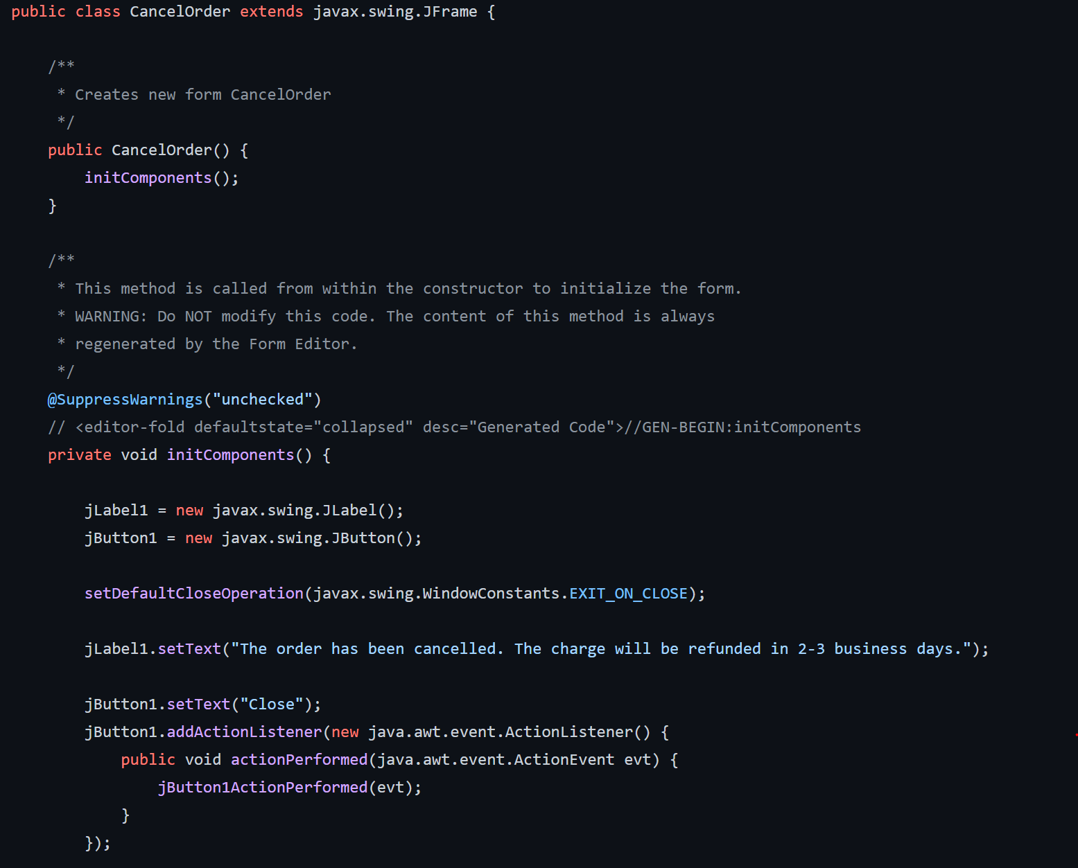
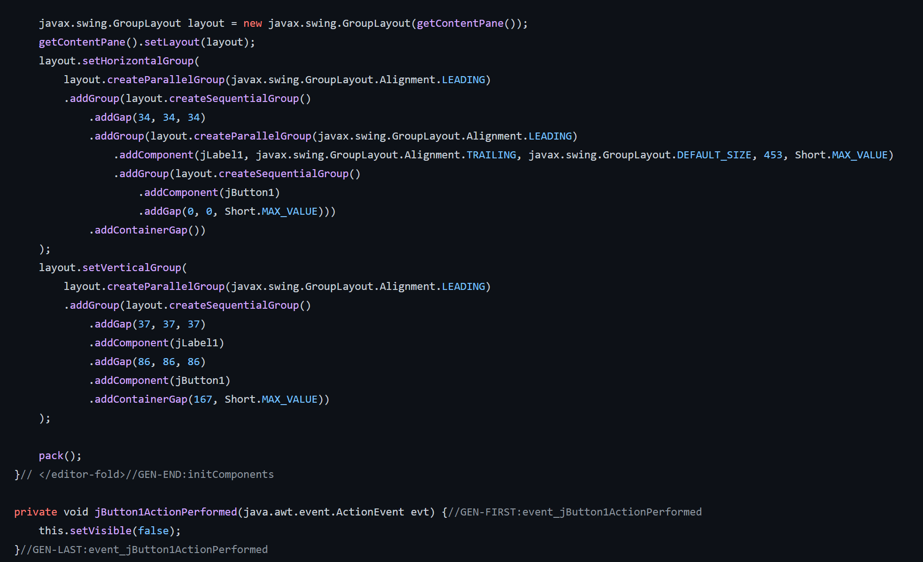
Our Implementation
Cancelling an Order

Slide 26
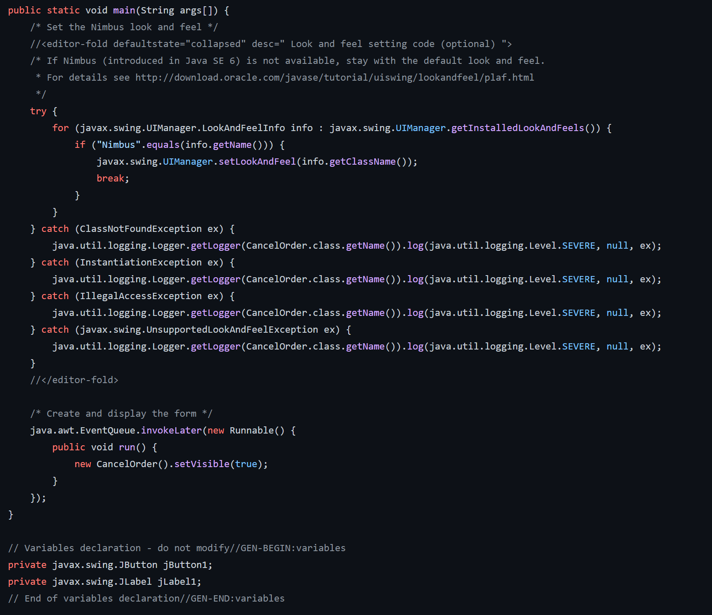
Our Implementation
Cancelling an Order

Slide 27
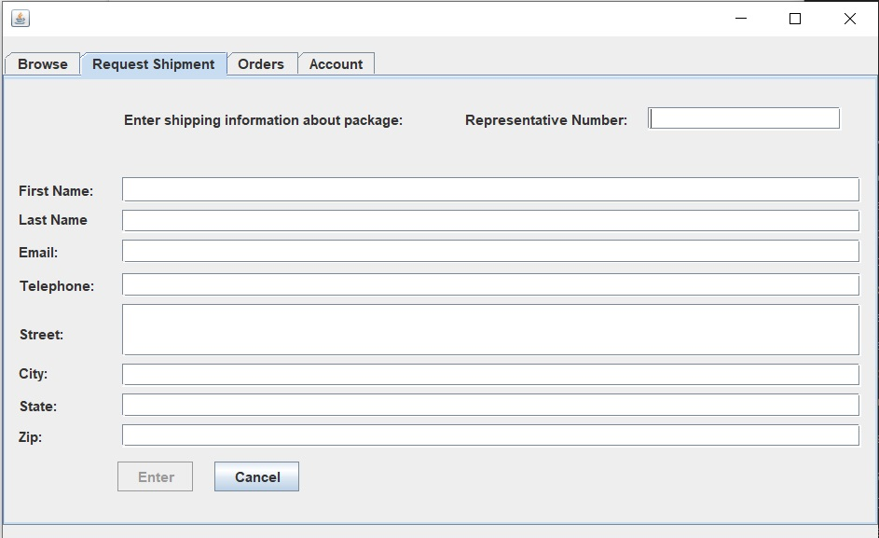
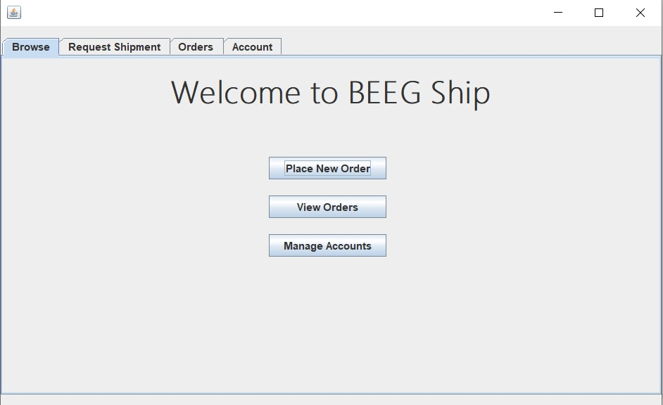
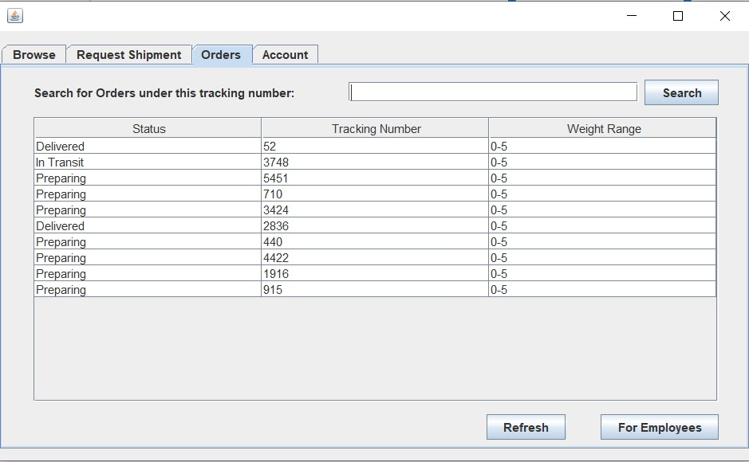
GUI Snapshots

Slide 28
BeegShip Presentation Demo

Slide 29
What we learned:
Being able to apply object oriented design programming and the SDLC to answer real world problems.
Develop Use case, Activity, SSD diagrams to develop a subsystem.
Develop relational databases and implement them in a way that meets business needs(Company X in our case).
Understanding how to write effective queries effectively for input and output in order to manage our database tables.
The process can be applied to an outnumbered world problems such as maintaining a bookstore database purchase, car dealership subsystems, keeping an inventory count of store products.

Slide 30
Difficulties/Challenges Encountered
Making sure the database worked properly upon adding new information to tables.
Deciding whether to use Mysql or Microsoft access to create our database tables.
Connecting Graphical user interface to work properly with our system. Making sure that each interface would retrieve the right information and send it to the database.
Implementing checks to verify that parent tables have the correct record when inserting records in children tables.
Creating new tables when normalizing the database.

Slide 31
Questions?

